Slide 1
Pipelined basic instruction set simulation
Wei Hong and Tengyu Sun

Slide 2
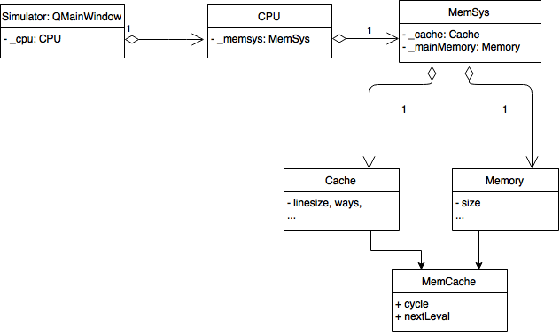
Architecture
Current stage

Slide 3
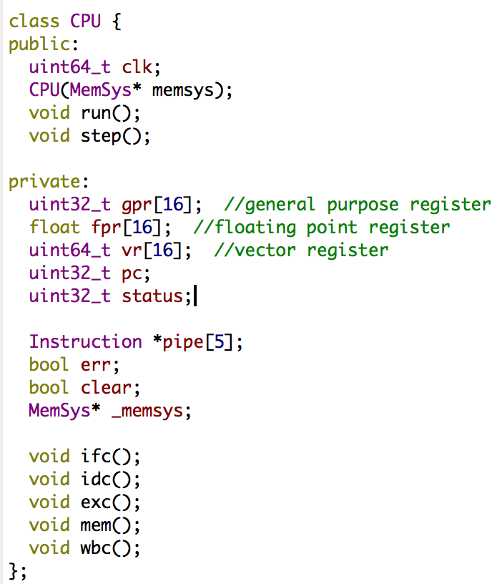
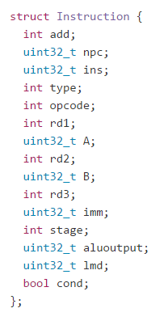
Implementation
Instruction state
5 stages
IF -> ID -> EX -> MEM -> WB
Pipeline
represented as an instruction array of size 5. The instruction objects are passed around the 5 stages
Registers
16 general purpose registers
16 floating point registers
16 vector registers
One program counter

Slide 4
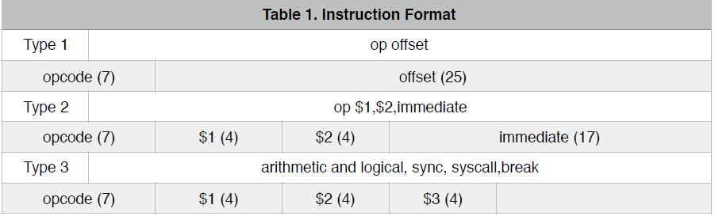
Instruction supported
Data transfer
lb, sb
Arithmetic and logical
add,sub
Control
bgez, break

Slide 5
Basic assembler
1-pass
Take assembly language clauses, parse into binary instruction
A more general one is under development
2-pass, support more types of instructions

Slide 6
Demo 1
Demo 2
preload mem[100] = 1, mem[101]=2
lb $0,$1,100 #$1 = 1
lb $0,$2,101 #$2 = 2
add $1,$2,$3 #$3 = $1 + $2 = 3
bgez $3,1 #$3>0, branch to sb…
lb $0,$3,100
sb $0,$3,102 #mem[102] = 3
break
preload mem[100] = 1, mem[101]=2
lb $0,$1,100 #$1 = 1
lb $0,$2,101 #$2 = 2
add $1,$2,$3 #$3 = $1 + $2 = 3
bgez $3,1 #$3>0, branch to sb…
lb $0,$3,100
sb $0,$3,102 #mem[102] = 3
break

